Slide 1
Speed Parkour
David Tsang
Blake Luo
TPS Parkour Game

Slide 2
Background
a person who is starting to play parkour. the player should help him to finish the level of different terrain.

Slide 3
Design

Slide 4
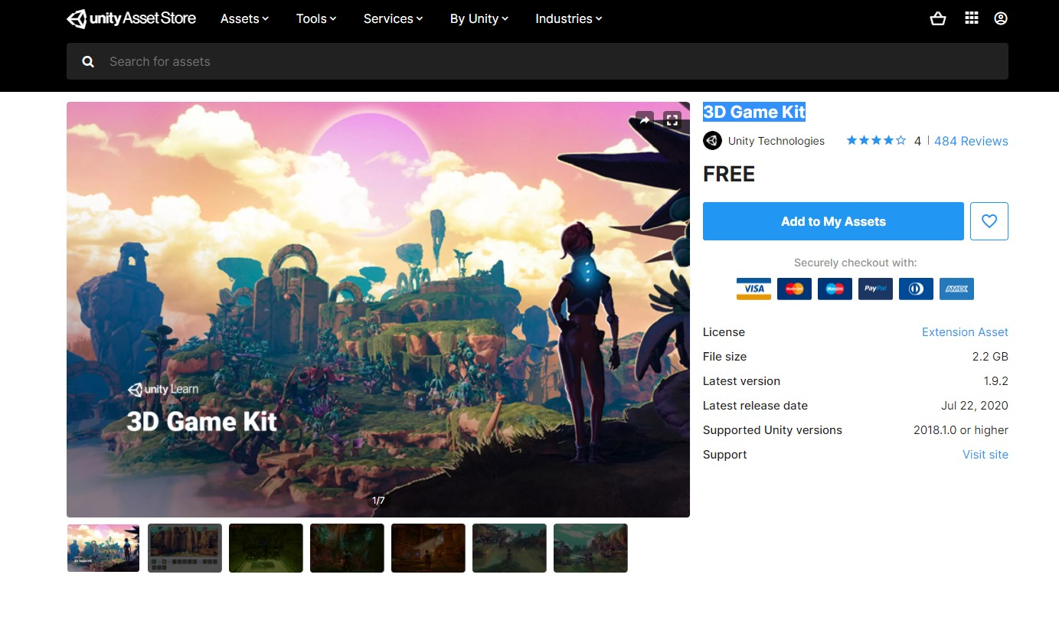
3D assets
All 3D assets are created by Blender
Assets from asset store
3D Game Kit
SkyBox

Slide 5
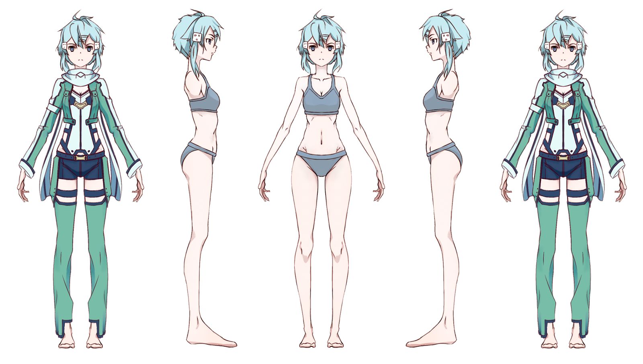
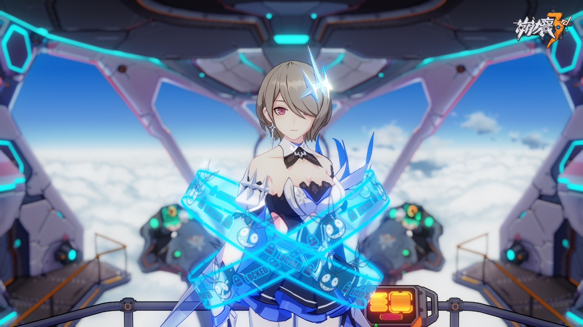
Charater Model Reference

Slide 6
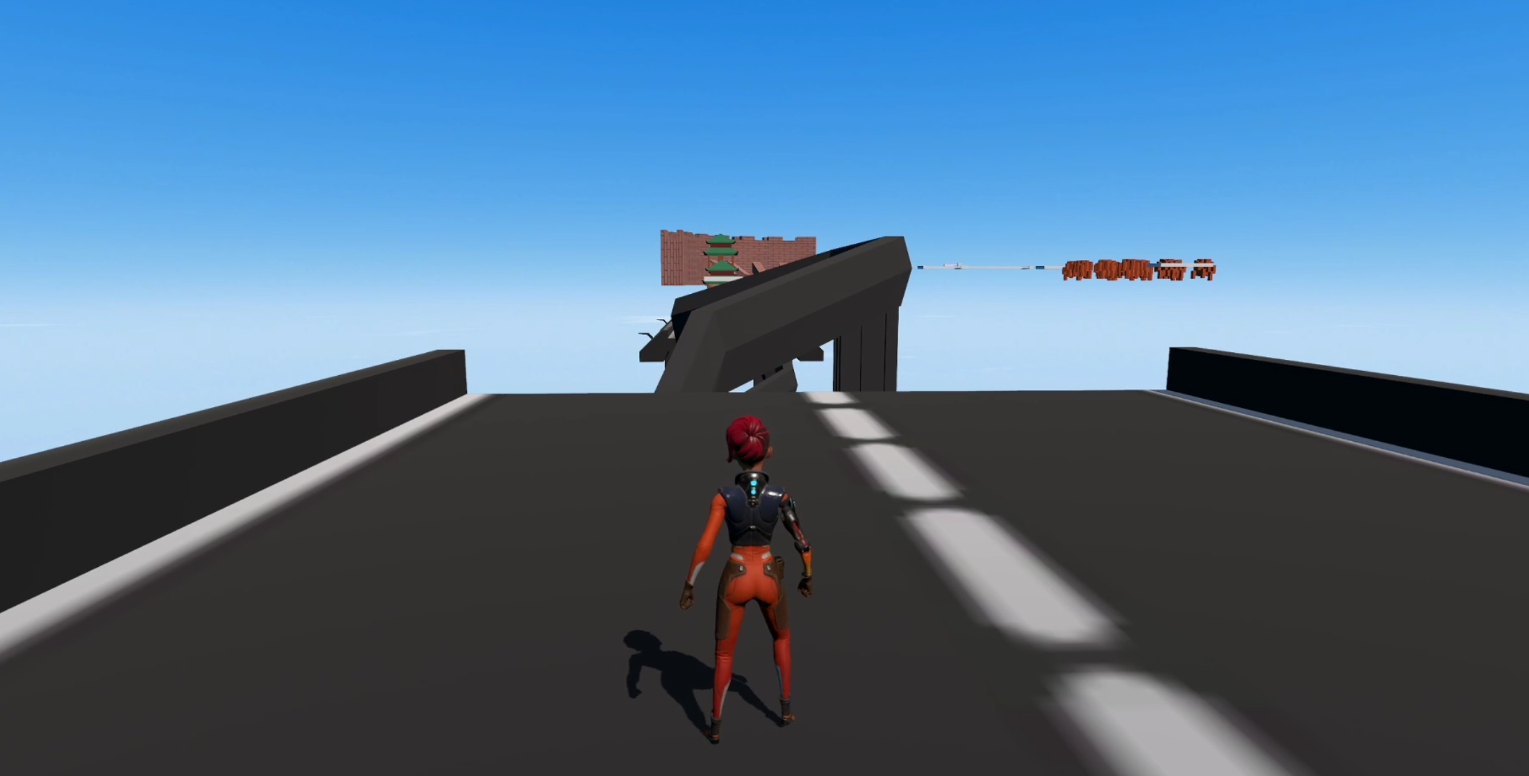
Game Play

Slide 7
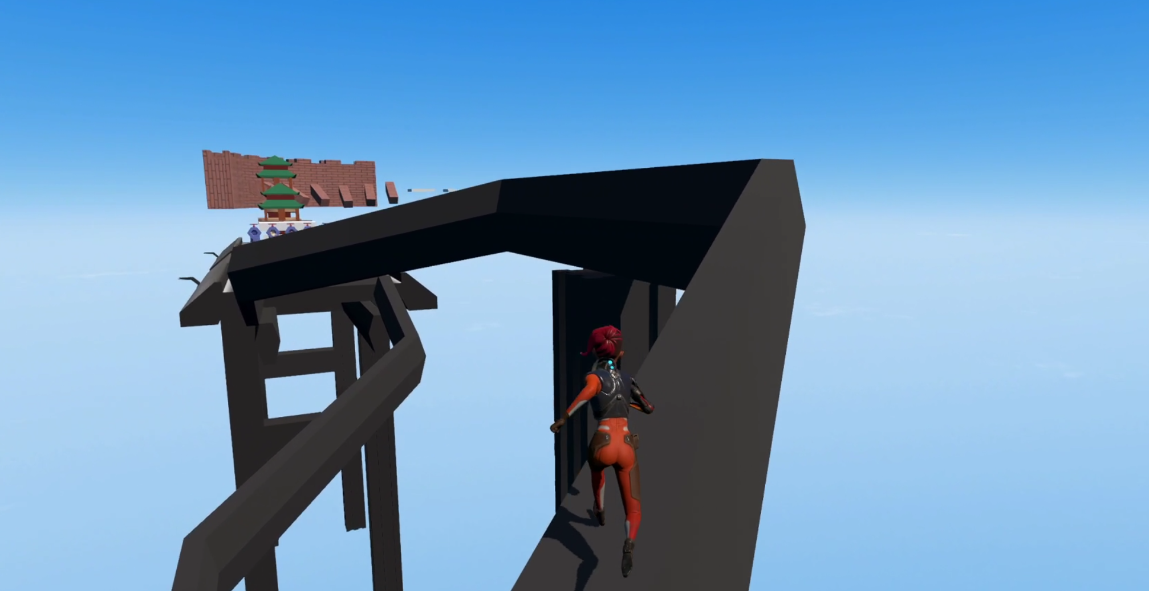
Start - Tube

Slide 8
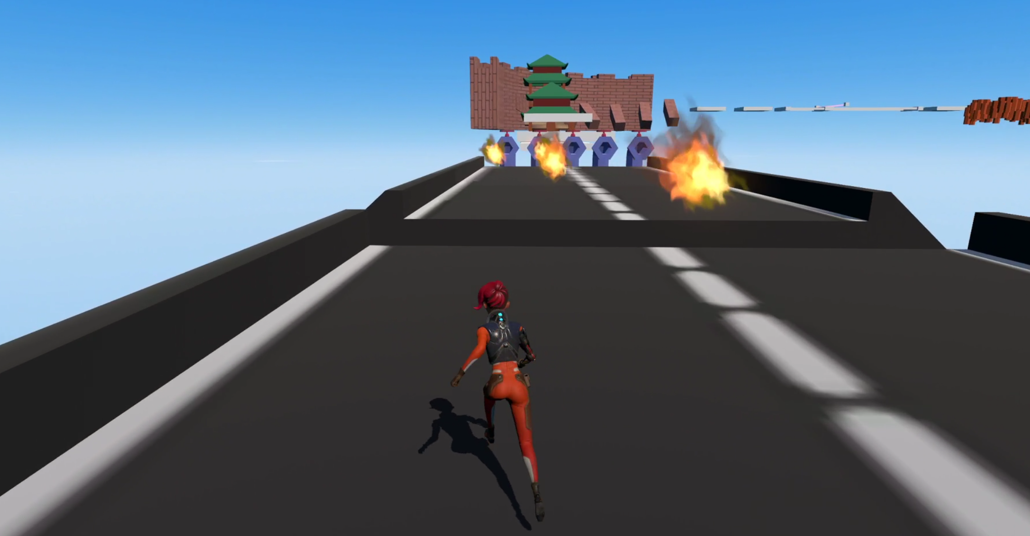
Tube - Fire

Slide 9
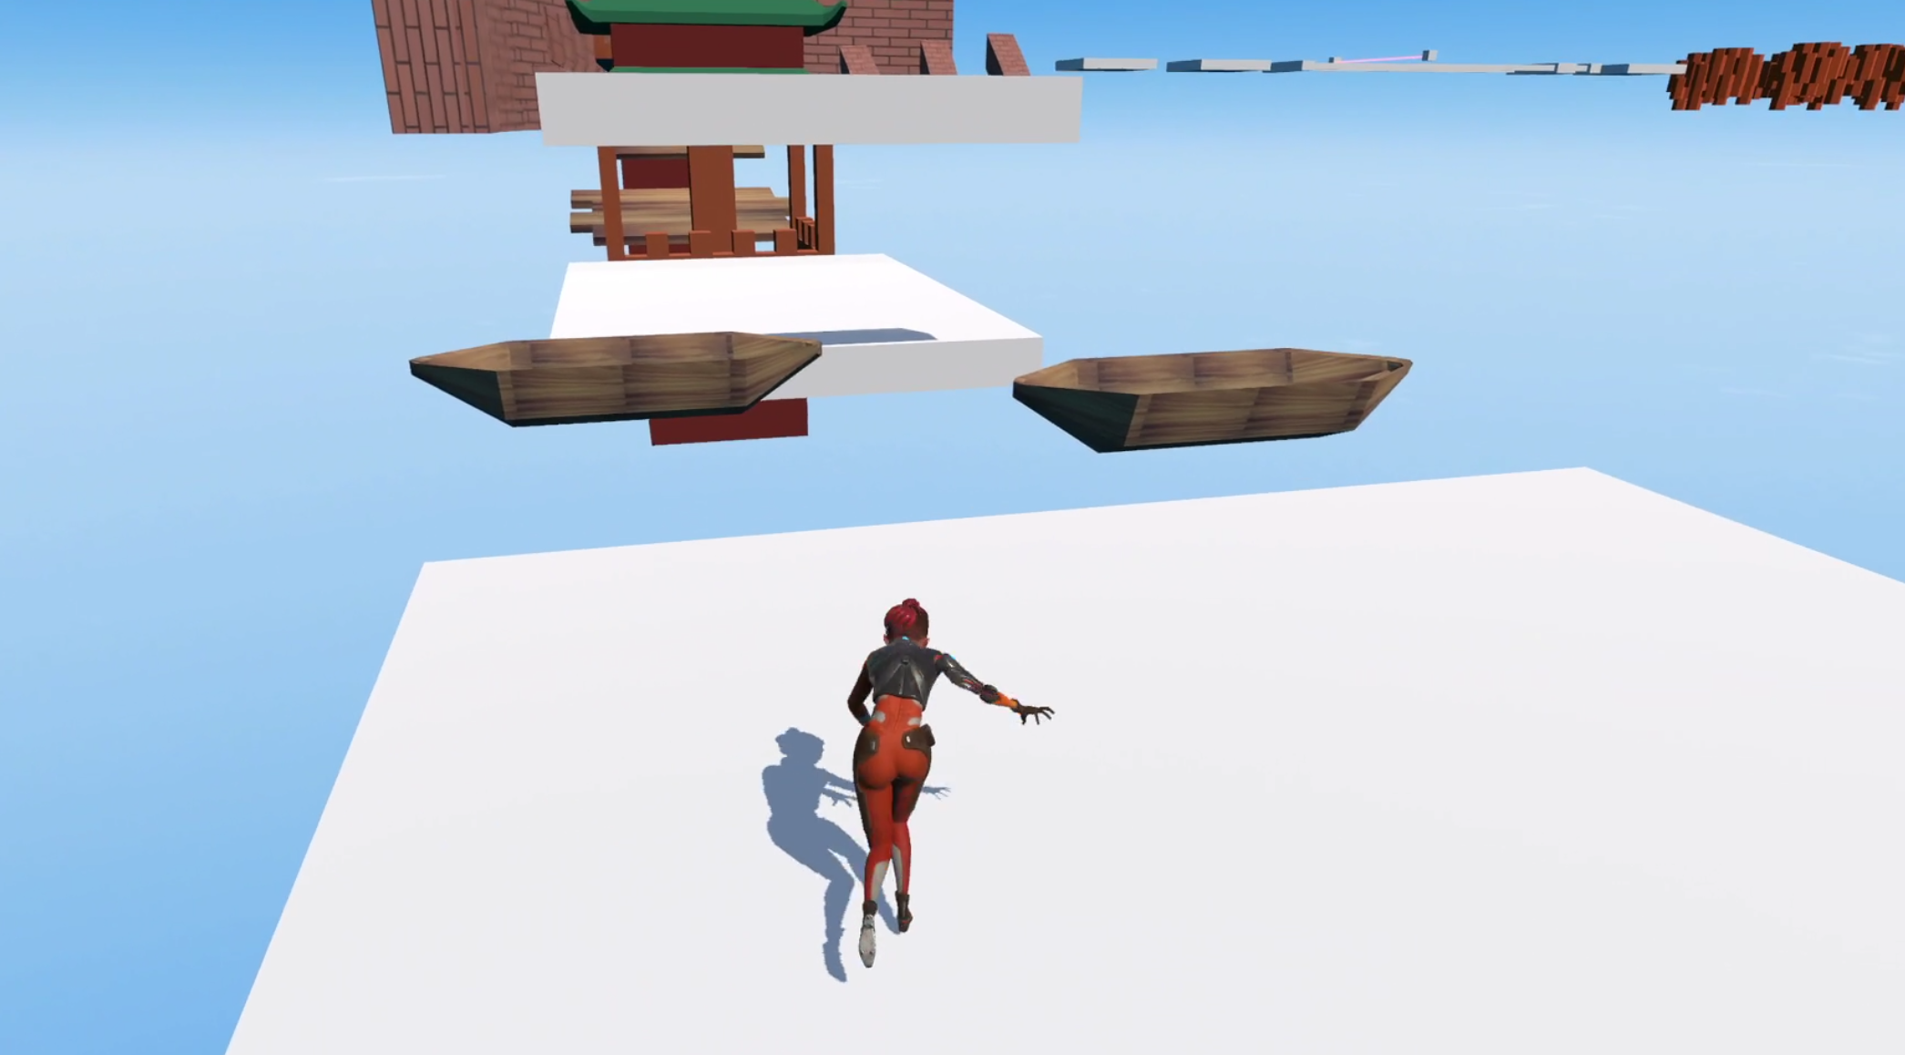
Wood Ship

Slide 10
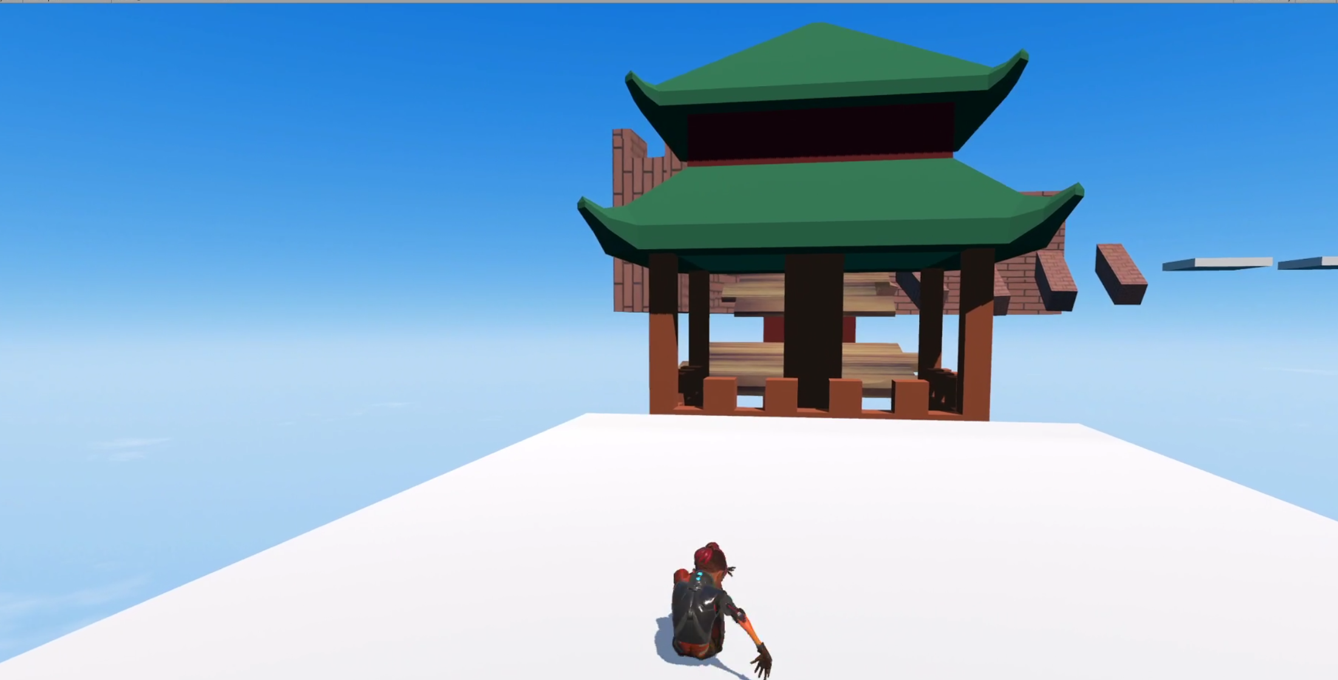
CN - Bridge

Slide 11
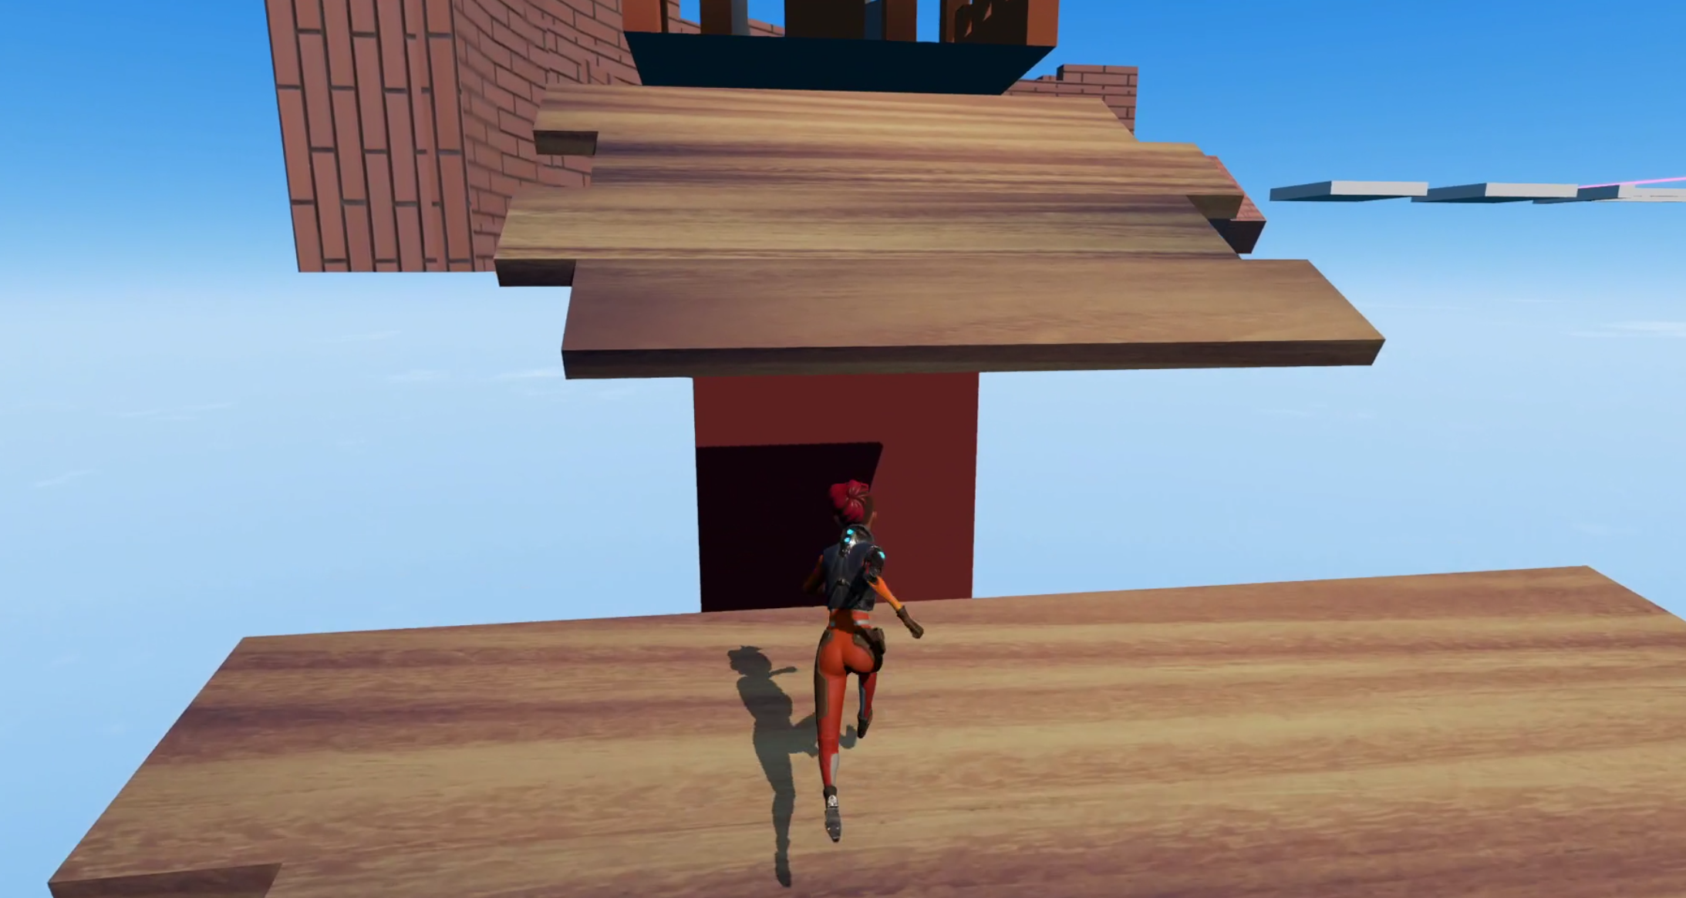
CN - Bridge

Slide 12
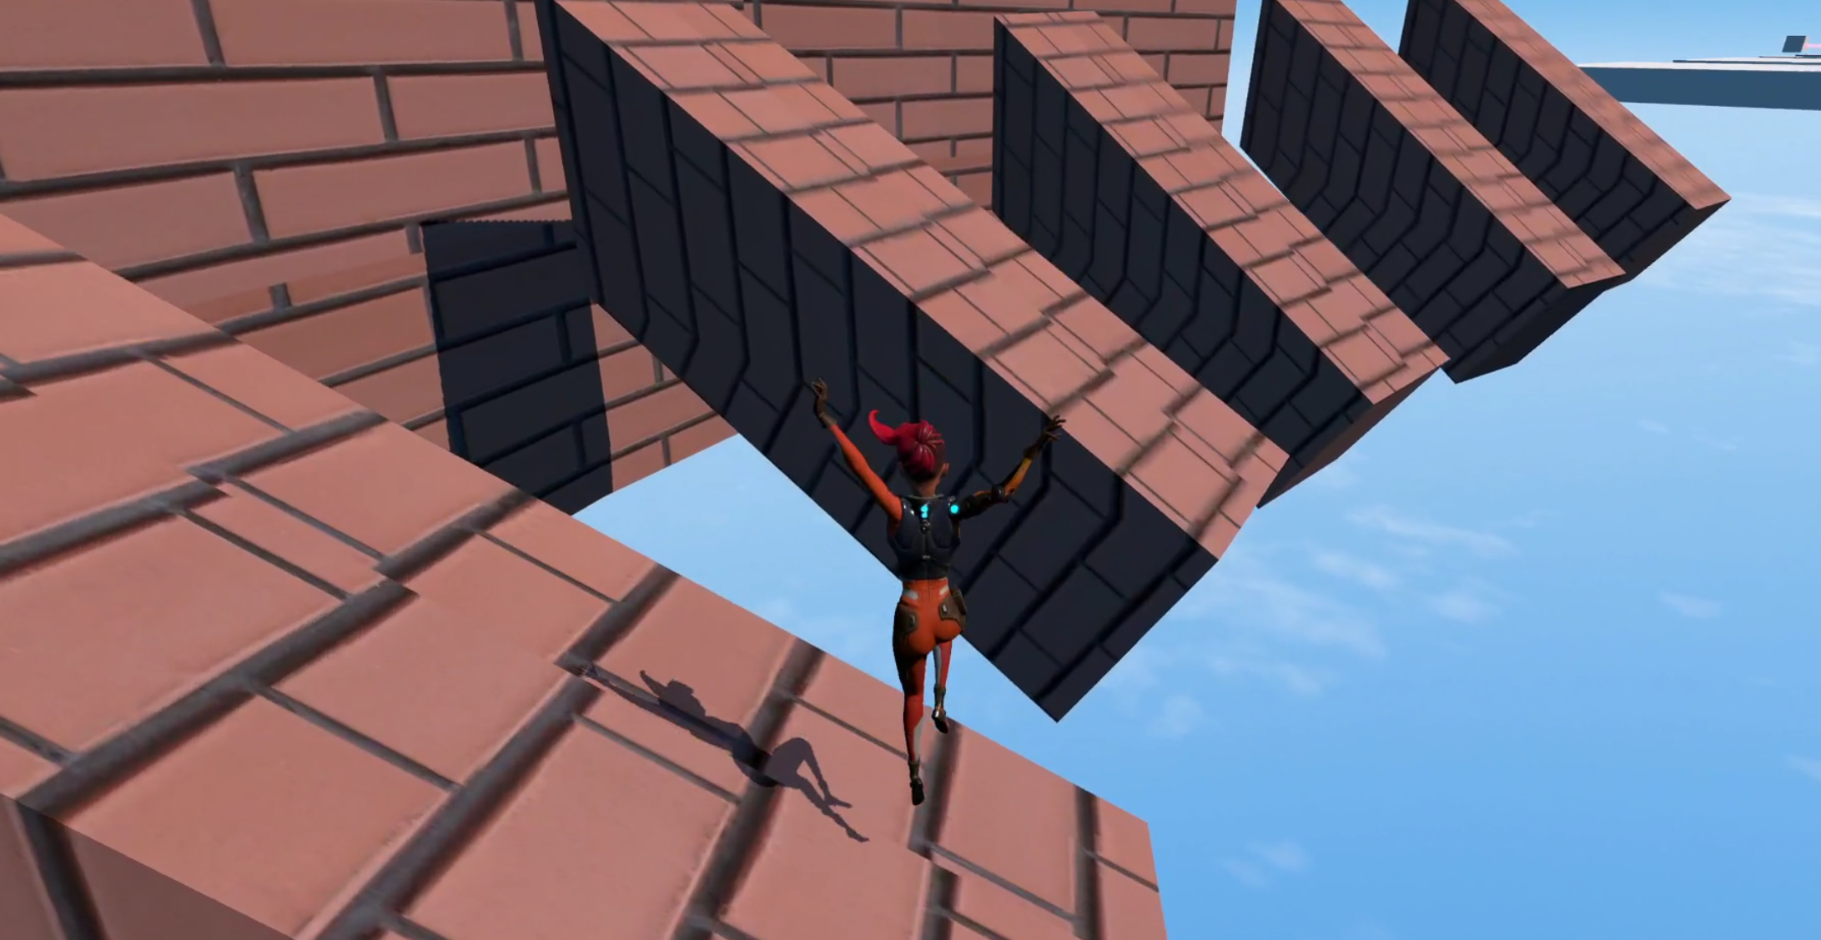
GraetWall

Slide 13
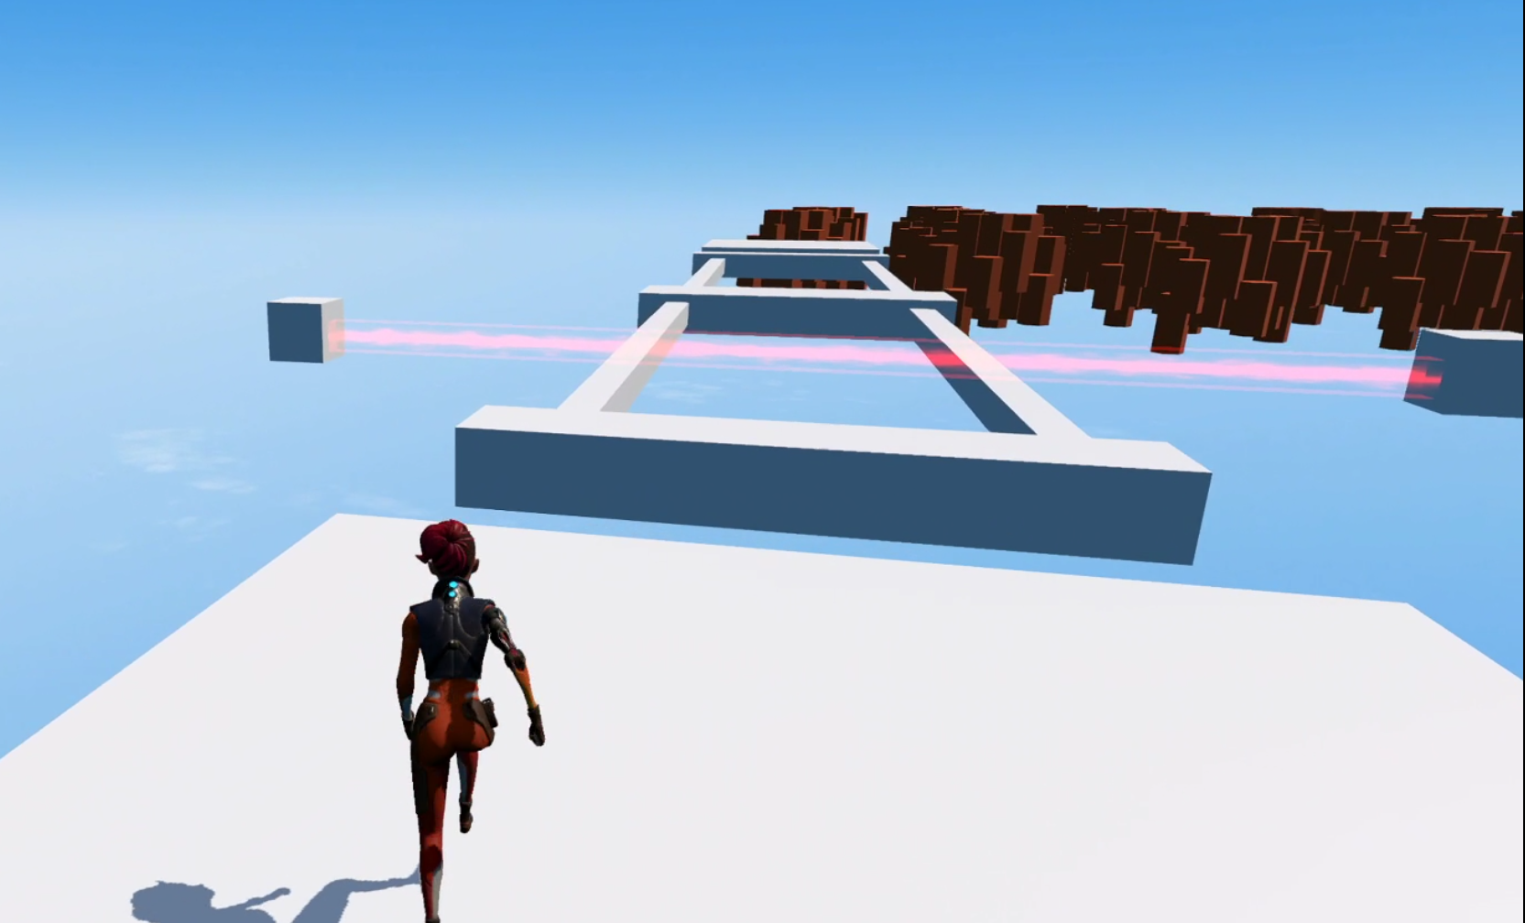
Laser

Slide 14
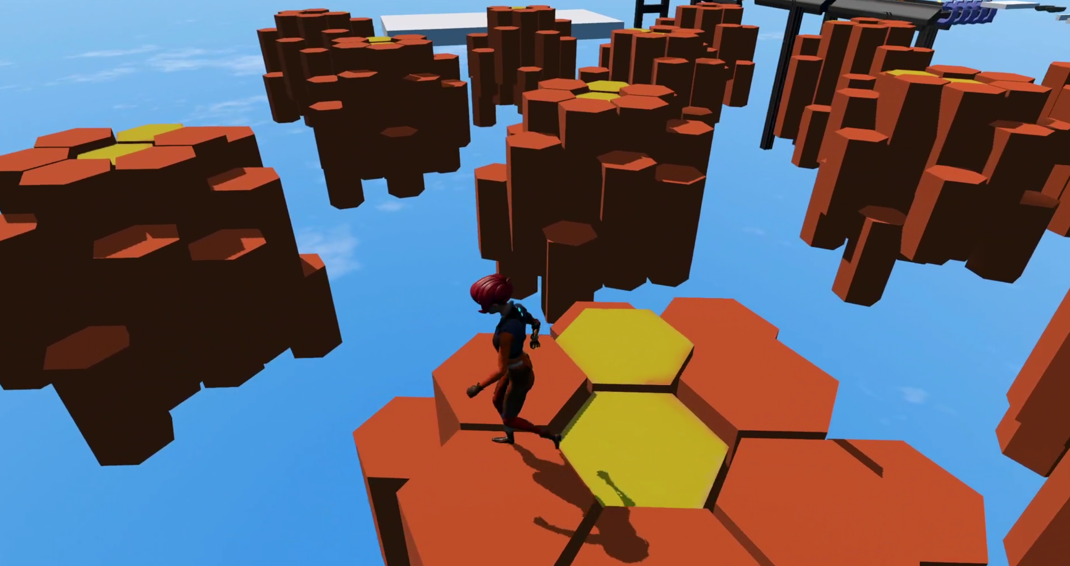
Floating Stone formation

Slide 15
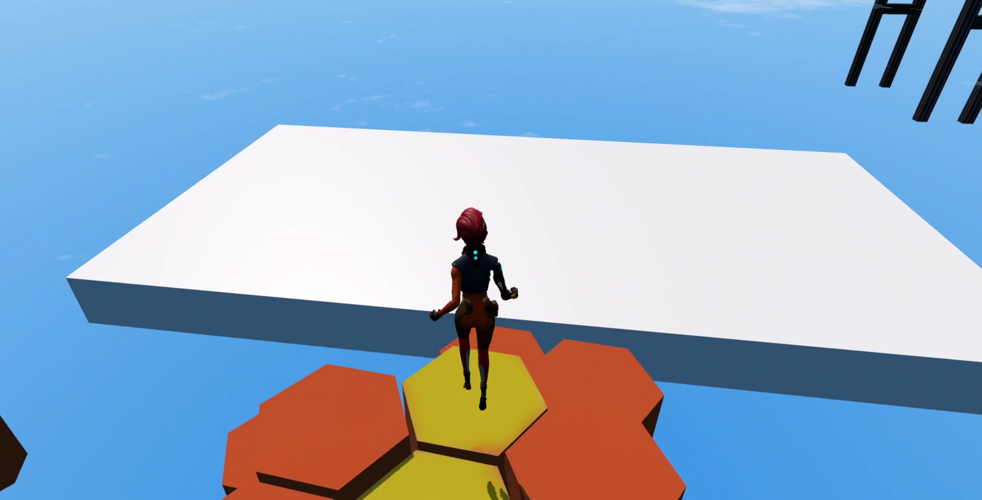
End (to next level - TBD)

Slide 16
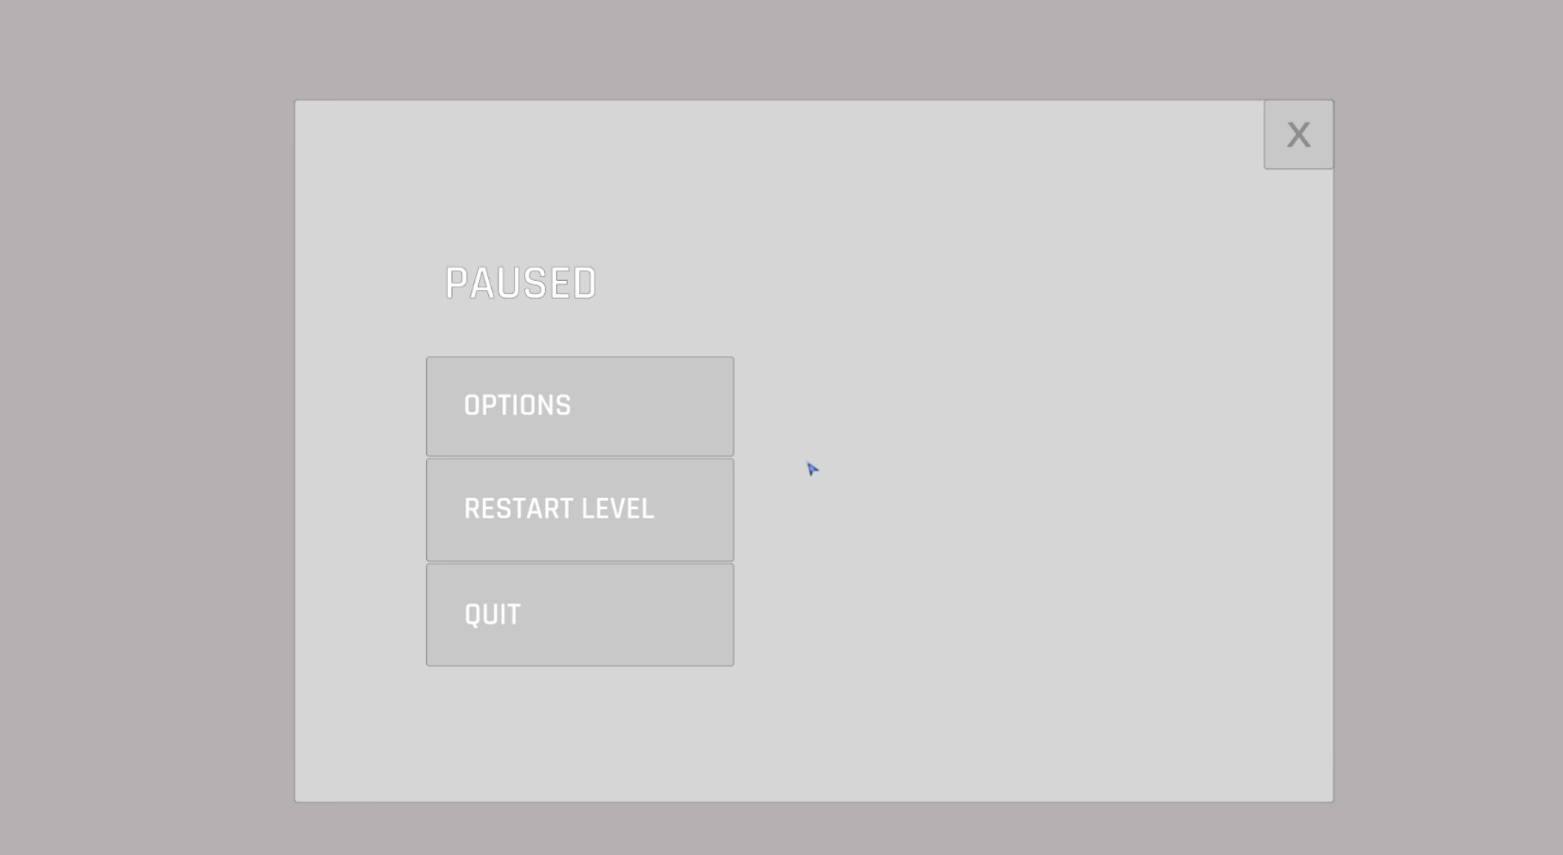
Menu

Slide 17
Comming Soon
New character model
One more harder levels
Terrian UPDATE(More Exterior Design)

